Slide 1

CSM-3
Vibe Coding
--Radha krishna

Slide 2

Vibe Coding
Home
About
Content
Others
What is Vibe Coding?
Vibe coding means building apps or websites with the help AI and this requires little or No Coding
Makes software development faster & Easier

Slide 3
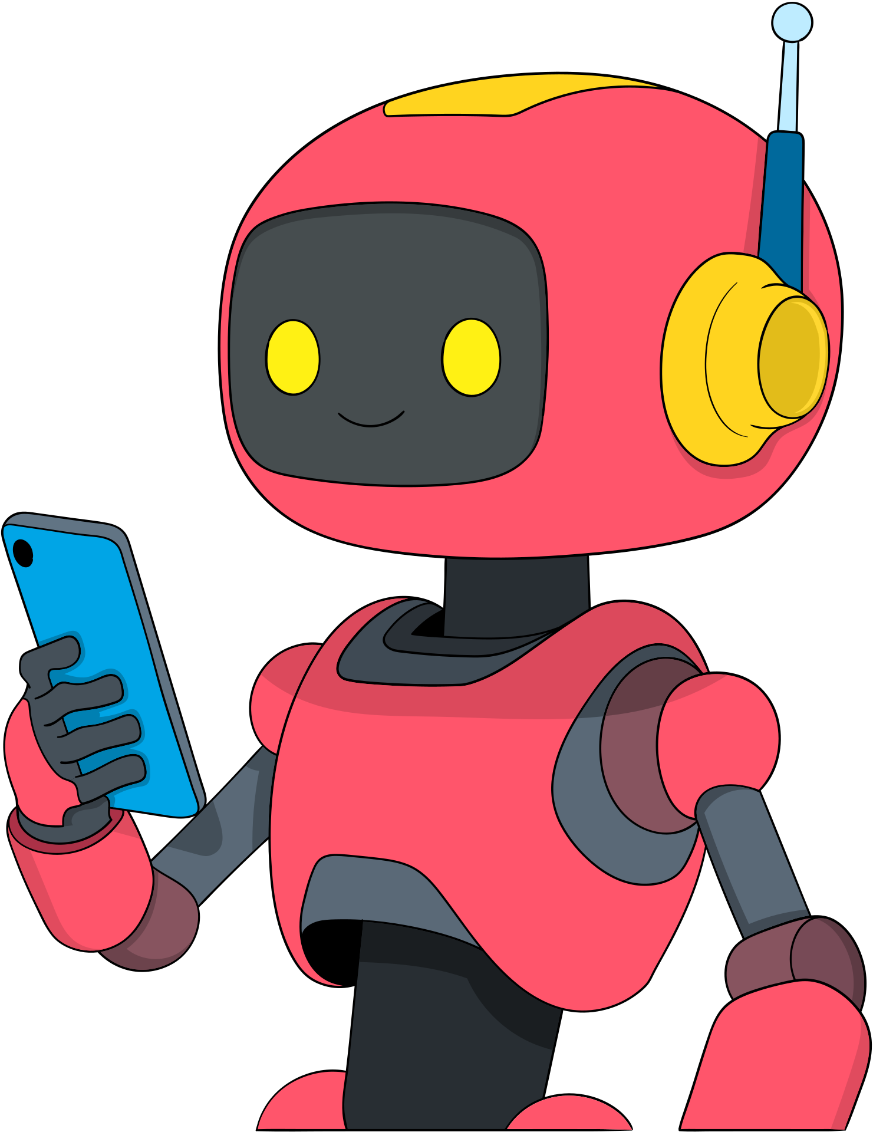
Vibe Coding
Home
About
Content
Others
Few Tools list which I Explored
POPULAR VIBE
CODING TOOLS
1. Lovable--For simple Websites
2. Emergent --it is used to create some backend also
3. Bolt--it like Lovable
4. Cursor--it like Lovable
5. Google firebase Studio--It is most powerful one

Slide 4
Vibe Coding
Home
About
Content
Others
Advantages
Ideal for startups and students
• Faster Development
• Low cost
• Encourages innovation
• No Deep Programming knowledge needed
From idea to app, no coding trap

Slide 5
Vibe Coding
Home
About
Content
Others
Limitations
• Limited customizationd
• Platform Dependency
• Not suitable for complex
Systems
• Performance issues in
Large apps
Explore many tools and find best one

Slide 6

Vibe Coding
Home
About
Content
Others
Are Jobs Safe in AI coding era ?
Absolutely No
It reduces repeatative and simple code and one thing technology changes jobs, not removes them.

Slide 7

Vibe Coding
Home
About
Content
Others
  Learn problem solving and logic
  Understand system design and architecture
  Combine coding skills with AI
How Developers can stay job-safe
Upgrade skills Continuously

Slide 8
Vibe Coding
Home
About
Content
Others
Thank You
-

